Slide 1
Classes-3
CS 244

Slide 2
Acknowledgement
Slides are from the textbook

Slide 3
Classes
Objects are created from a class
Format:
class ClassName
{
declaration;
declaration;
};
Notes:
3

Slide 4
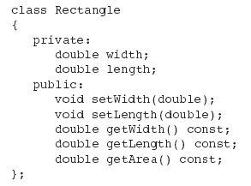
Class Example
Notes:
4

Slide 5
Access Specifiers
Used to control access to members of the class
public: can be accessed by functions outside of the class
private: can only be called by or accessed by functions that are members of the class
Notes:
5

Slide 6
Class Example
Private Members
Public Members
Notes:
6

Slide 7
More on Access Specifiers
Can be listed in any order in a class
Can appear multiple times in a class
If not specified, the default is private
Notes:
7

Slide 8

Using const With Member Functions
const appearing after the parentheses in a member function declaration specifies that the function will not change any data in the calling object.

Slide 9
Defining a Member Function
When defining a member function:
Put prototype in class declaration
Define function using class name and scope resolution operator (::)
int Rectangle::setWidth(double w)
{
width = w;
}
Notes:
9

Slide 10
Accessors and Mutators
Get and Set
Mutator: a member function that stores a value in a private member variable, or changes its value in some way
Accessor: function that retrieves a value from a private member variable. Accessors do not change an object's data, so they should be marked const.
Notes:
10

Slide 11
Defining an Instance of a Class
An object is an instance of a class
Defined like structure variables:
Rectangle r;
Access members using dot operator:
r.setWidth(5.2);
cout << r.getWidth();
Compiler error if attempt to access private member using dot operator
Notes:
11

Slide 12
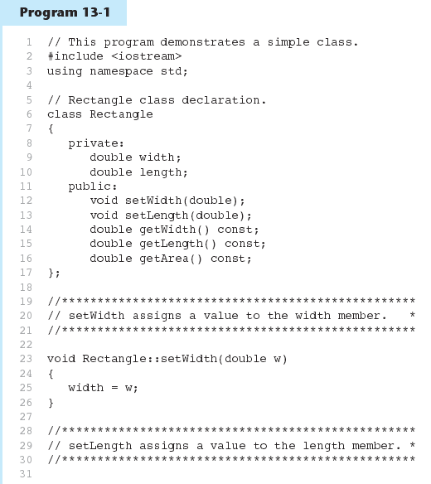

Slide 13
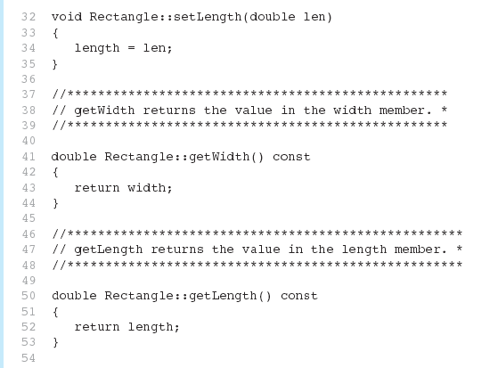
Program 13-1 (Continued)

Slide 14
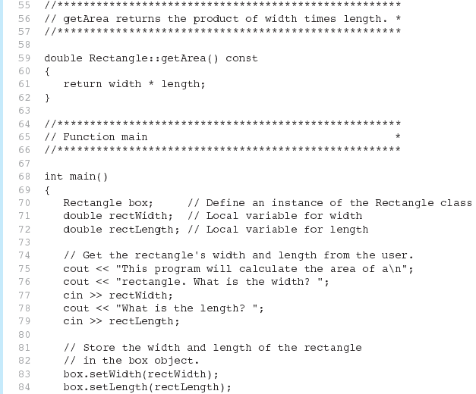
Program 13-1 (Continued)

Slide 15
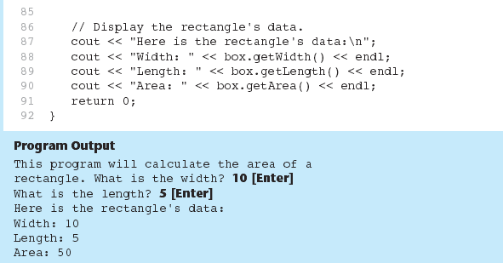
Program 13-1 (Continued)

Slide 16
Avoiding Stale Data
Some data is the result of a calculation.
In the Rectangle class the area of a rectangle is calculated.
length x width
If we were to use an area variable here in the Rectangle class, its value would be dependent on the length and the width.
If we change length or width without updating area, then area would become stale.
To avoid stale data, it is best to calculate the value of that data within a member function rather than store it in a variable.

Slide 17
Why Have Private Members?
Making data members private provides data protection
Data can be accessed only through public functions
Public functions define the class’s public interface
Notes:
17

Slide 18
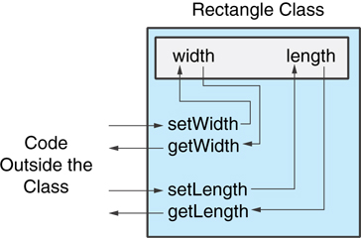
Code outside the class must use the class's public member functions to interact with the object.

Slide 19
Separating Specification from Implementation
Place class declaration in a header file that serves as the class specification file. Name the file ClassName.h, for example, Rectangle.h
Place member function definitions in ClassName.cpp, for example, Rectangle.cpp File should #include the class specification file
Programs that use the class must #include the class specification file, and be compiled and linked with the member function definitions
Notes:
19

Slide 20
Inline Member Functions
Member functions can be defined
inline: in class declaration
after the class declaration
Inline appropriate for short function bodies:
int getWidth() const { return width; }
Notes:
20

Slide 21
Rectangle Class with Inline Member Functions
1 // Specification file for the Rectangle class 2 // This version uses some inline member functions. 3 #ifndef RECTANGLE_H 4 #define RECTANGLE_H 5 6 class Rectangle 7 { 8 private: 9 double width; 10 double length; 11 public: 12 void setWidth(double); 13 void setLength(double); 14 15 double getWidth() const 16 { return width; } 17 18 double getLength() const 19 { return length; } 20 21 double getArea() const 22 { return width * length; } 23 }; 24 #endif

Slide 22
Tradeoffs – Inline vs. Regular Member Functions
Regular functions – when called, compiler stores return address of call, allocates memory for local variables, etc.
Code for an inline function is copied into program in place of call – larger executable program, but no function call overhead, hence faster execution
Notes:
22

Slide 23
Constructors
Member function that is automatically called when an object is created
Purpose is to construct an object
Constructor function name is class name
Has no return type
Notes:
23

Slide 24
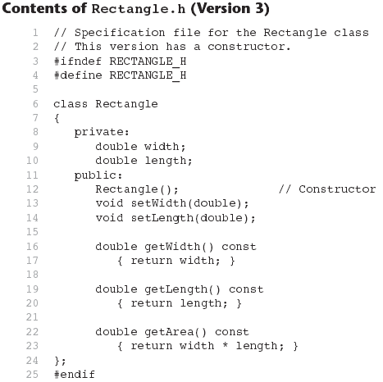

Slide 25
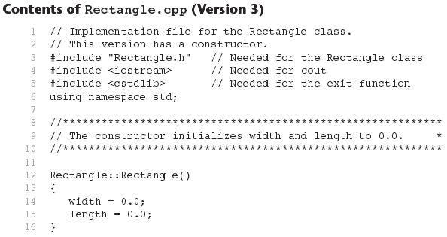
Continues...

Slide 26
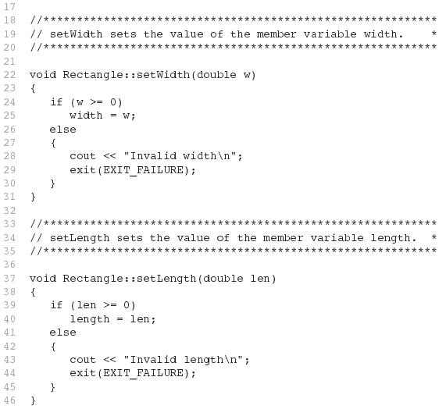
Contents of Rectangle.ccp Version3 (continued)

Slide 27
Default Constructors
A default constructor is a constructor that takes no arguments.
If you write a class with no constructor at all, C++ will write a default constructor for you, one that does nothing.
A simple instantiation of a class (with no arguments) calls the default constructor:
Rectangle r;

Slide 28
Passing Arguments to Constructors
To create a constructor that takes arguments:
indicate parameters in prototype: Rectangle(double, double);
Use parameters in the definition: Rectangle::Rectangle(double w, double len) { width = w; length = len; }
Notes:
28

Slide 29
Passing Arguments to Constructors
You can pass arguments to the constructor when you create an object:
Rectangle r(10, 5);
Notes:
29

Slide 30
More About Default Constructors
If all of a constructor's parameters have default arguments, then it is a default constructor. For example:
Rectangle(double = 0, double = 0);
Creating an object and passing no arguments will cause this constructor to execute: Rectangle r;

Slide 31
Classes with No Default Constructor
When all of a class's constructors require arguments, then the class has NO default constructor.
When this is the case, you must pass the required arguments to the constructor when creating an object.

Slide 32
Overloading Constructors
A class can have more than one constructor
Overloaded constructors in a class must have different parameter lists:
Rectangle(); Rectangle(double);
Rectangle(double, double);
Notes:
32

Slide 33
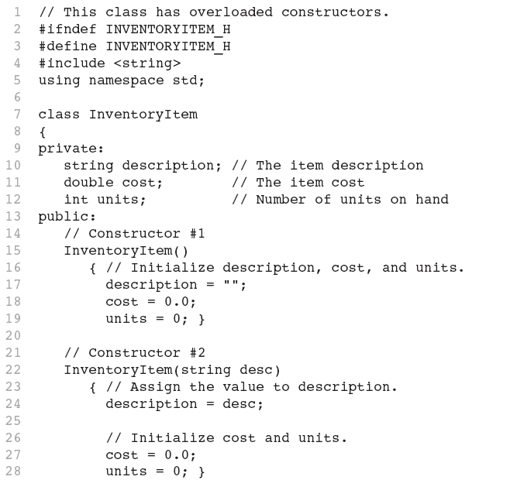
Continues...

Slide 34
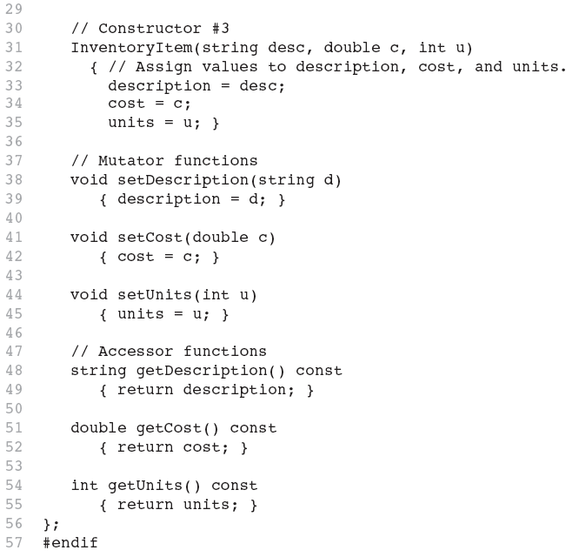

Slide 35
Member Function Overloading
Non-constructor member functions can also be overloaded:
void setCost(double);
void setCost(char *);
Must have unique parameter lists as for constructors
Notes:
35

Slide 36
Using Private Member Functions
A private member function can only be called by another member function
It is used for internal processing by the class, not for use outside of the class
See the createDescription function in ContactInfo.h (Version 2)
Notes:
36

Slide 37
Arrays of Objects
Objects can be the elements of an array:
InventoryItem inventory[40];
Default constructor for object is used when array is defined
Notes:
37

Slide 38
Arrays of Objects
Must use initializer list to invoke constructor that takes arguments:
InventoryItem inventory[3] = { "Hammer", "Wrench", "Pliers" };
Notes:
38

Slide 39

Arrays of Objects
If the constructor requires more than one argument, the initializer must take the form of a function call:
Notes:
39

Slide 40

Arrays of Objects
It isn't necessary to call the same constructor for each object in an array:

Slide 41
Accessing Objects in an Array
Objects in an array are referenced using subscripts
Member functions are referenced using dot notation:
inventory[2].setUnits(30);
cout << inventory[2].getUnits();
Notes:
41

